Slide 1


What the History of LLMs Teaches Us
The Graph Courses

Slide 2



How to choose an LLM Model
• Token = chunk of text. See: platform.openai.com/tokenizer
• 100 token roughly equal 75 words.
• Modern models have huge limits (1M tokens ~ entire bible)
• Fits in context ≠ Good responses
• Use RAG to surpass context limit.
6 Factors to consider
Context Limit
Identifying Key Challenges
Comprehensive list of major pain points (e.g., supplier issues, demand fluctuations, cost inefficiencies).Assessment of current impacts on business performance.
Creative Solutions for Supply Chain Optimization
Create an open space for idea generation with prompts that inspire the team to think about innovation, technology adoption, and process improvements.
Action Plan
@reallygreatsite
Compile the top 3 to 5 ideas from the brainstorming session.Assign responsibilities and timelines for each task.

Slide 3
Context Limit (tokens)
• Token = chunk of text. See: platform.openai.com/tokenizer
• 100 tokens roughly equal 75 words.
• Modern models have huge limits (1M tokens ~ entire bible)
• Fits in context ≠ Good responses
• Use RAG to surpass context limit.
Performance
• Check public leaderboards to shortlist candidates.
• lmarena: https://beta.lmarena.ai/leaderboard
• artificial analysis
• Run your own evals
Price
• Price typically listed per million tokens
• Input vs Output
• Test cheap models first
Speed
• Cheap small, less intelligent models usually faster
• For chatbots, interactive apps, consider fast models
• For async processes, not a big consideration
Reasoning vs Standard models
• Reasoning models offer but slow response time and increased cost (reasoning tokens are billed)
Open vs Closed weights
• Open‑weight models (eg. Deepseek, Llama 3) can run on your infra — lower cost & control.
• Closed‑weight APIs offer performance and convenience but more costly.
Feature ↓ / Model → | 4.1-mini | 4.1 | o4-mini | 3.5 Haiku | 4 Opus | 3.7 Sonnet † | 2.5 Flash | 2.5 Pro | 2.5 Pro † | Scout | Maverick | DeepSeek R1
Context limit | 1 M | 1 M | 0.2 M | 200 K | 200 K | 200 K | 1 M | 1 M | 1 M | 10 M | 1 M | 128 K
Performance* | 53 | 53 | 70 | 35 | 58 | 57 | 53 | 69 | 69 | 43 II | 51 II | 60 II
Price ($/1 M tok) (in / out) | 0.40 / 1.60 | 2.00 / 8.00 | 1.10 / 4.40 | 0.80 / 4.00 | 15 / 75 | 3 / 15 | 0.15 / 0.60 | 1.25 / 10 | 1.25 / 10 | 0.16 / 0.54 | 0.21 / 0.85 | 0.55 / 2.19
Speed (fastest provider on openrouter) | 1 | 5 | 2.75 | 2.4 | 45 | 9 | 0.38 | 5.63 | 5.63 | 0.35 | 0.53 | 1.37
Thinking mode? (available on openrouter) | — | — | ✓ | — | ✓ | ✓ | — | — | ✓ | — | — | ✓
Open / Closed | Closed | Closed | Closed | Closed | Closed | Closed | Closed | Closed | Closed | Open | Open | Open

Slide 4
How to choose an LLM Model
6 Factors to consider
Choosing the Right Large Language Model (LLM)
Typical Use‑Cases in This Course
• Google Sheets LLM functions — short prompts, tabular data
• Botpress chatbots — conversational context, real‑time
• Lindy automations — back‑office tasks where cost matters
Context Window & Tokens
Tokens are chunks of text. Every model has a limit (e.g., 4k, 16k, 128k tokens).
Add input tokens + output tokens ≤ limit. Pick a model that fits your longest prompt + data.
Performance & Benchmarks
Estimate monthly usage: calls × (prompt + completion tokens) × price.
Check public leaderboards (MMLU, MT‑Bench, GSM‑8K …) to shortlist candidates,
Open vs Closed Weights
Open‑weight models (eg. Mixtral, Llama 3) can run on your infra — lower cost & control.
Closed‑weight APIs (eg. GPT‑4o, Claude 3) offer top accuracy but you rely on the vendor.
Pricing
Speed & Latency
Cheaper / smaller models often respond fastest — crucial for user‑facing chatbots.
Large models may stream partial answers; you can trade speed for quality.
Prototype with 2‑3 models, then measure quality, cost & speed on your own data.
Reasoning vs Pattern Matching
High‑end models excel at multi‑step reasoning and tool use; great for agents.
Lighter models shine at extraction, re‑formatting, and summaries.

Slide 5
Performance
• Ways to assess:
• artificial analysis
• lmarena: https://beta.lmarena.ai/leaderboard
OpenAI
Google
Anthropic
Meta
Smaller, cheaper, less intelligent
GPT 4.1 mini
Gemini 2.5 Flash
Claude 3.7 Haiku
Llama 4 scout
Bigger, more pricey, more intelligent
GPT 4.1,
o-series
Gemini 2.5 Pro
Claude 3.7 Sonnet
Llama 4 maverick

Slide 6
Pricing
• Pricing. Models charge per token (input + output). Prices vary a lot.
OpenAI
Google
Anthropic
Meta
Smaller, cheaper, less intelligent
GPT 4.1 mini
Gemini 2.5 Flash
Claude 3.7 Haiku
Llama 4 scout
Bigger, more pricey, more intelligent
GPT 4.1,
o-series
Gemini 2.5 Pro
Claude 3.7 Sonnet
Llama 4 maverick

Slide 7
Speed
• Generally, cheaper models = faster responses. Speed matters more for real-time applications like chatbots.
OpenAI
Google
Anthropic
Meta
Smaller, cheaper, less intelligent
GPT 4.1 mini
Gemini 2.5 Flash
Bigger, more pricey, more intelligent
GPT 4.1
Gemini 2.5 Pro
Reasoning

Slide 8
Reasoning vs non-reasoning
• Reasoning models (like OpenAI's o1) "think" longer before responding, giving better answers for complex problems.
Use reasoning models for:
Complex math or logic problems
Multi-step analysis
Code debugging
OpenAI
Google
Anthropic
Meta
Smaller, cheaper, less intelligent
GPT 4.1 mini
Gemini 2.5 Flash
Bigger, more pricey, more intelligent
GPT 4.1
Gemini 2.5 Pro
Reasoning

Slide 9
Open vs closed source
…

Slide 10
models
OpenAI
Google
Anthropic
Meta
Smaller, cheaper, less intelligent
GPT 4.1 mini
Gemini 2.5 Flash
Bigger, more pricey, more intelligent
GPT 4.1
Gemini 2.5 Pro
Reasoning

Slide 11
Panel 4: Segregational Drift
Legend:
Lysogenic
Cell lysis
(stable)
(cycle restart)
Wild-type lysogenic
Cell division
Mutant lytic
Infection flow

Slide 12
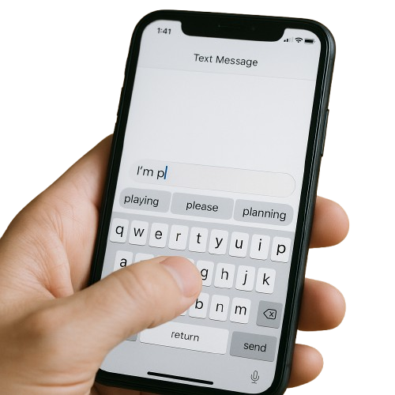
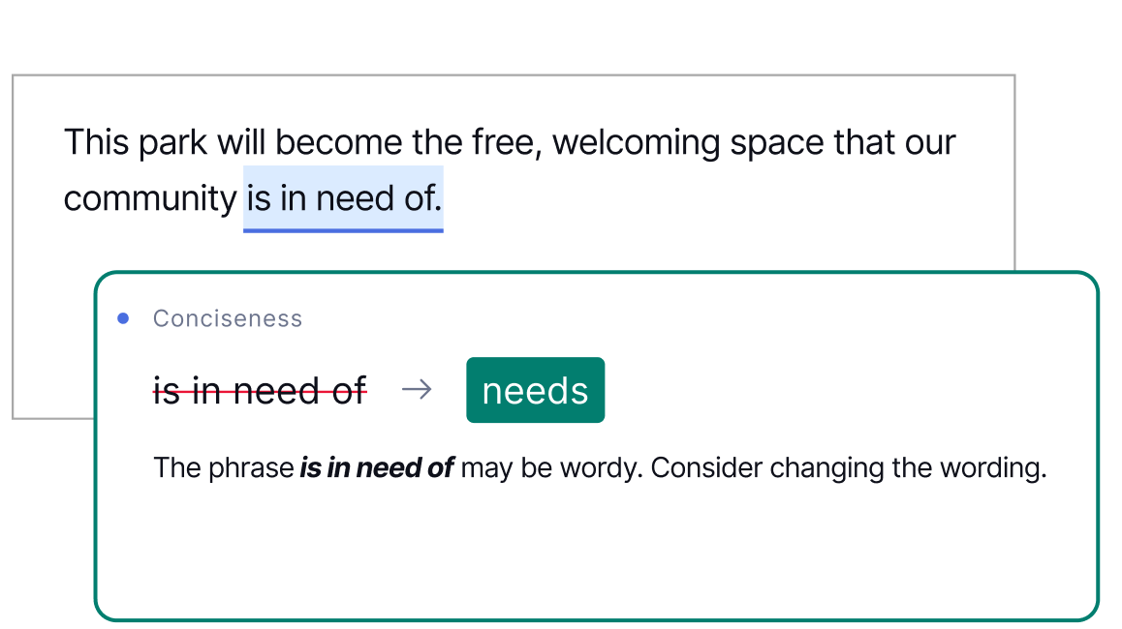


What is a Language Model?
A computer system that learns patterns from text data to predict and generate language.
e.g. Google Translate, texting autocomplete, grammar checkers, LLMs

Slide 13
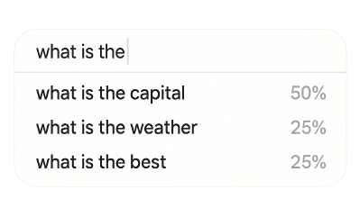
A Very Simple Language Model: Fourgram
• A fourgram estimates the probability of a word based on the three words that come right before it. Bigrams, trigrams etc. also common
• N-grams used in search boxes, autocomplete.
Toy example of fourgram model:
Training Corpus:
Language Model Output:
how to bake bread
weather today london uk
what is the weather like today
what is the capital of spain
what is the capital of france
best coffee shops nearby
what is the best way to learn French
Model sees "what is the," and checks how this phrase was completed in the corpus.
"Capital" came next 2 times, "weather" 1 time, and "best" 1 time. So it thinks "capital" is more likely to follow.

Slide 14
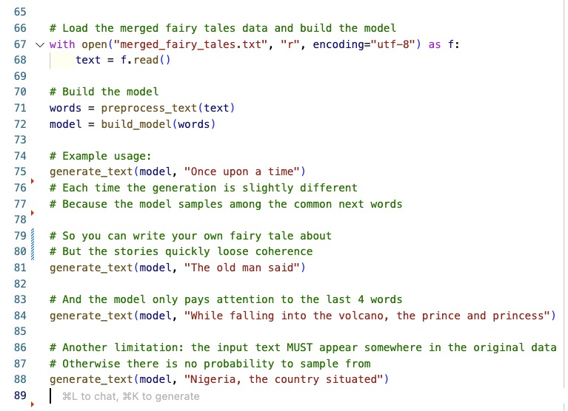
Live demo: fivegram trained on children’s storybooks
Summary of demo
• n-gram uses naïve training/inference (just counting; no understanding)
• Extremely limited context
• But still proof of concept: statistical learning from text can produce (partly) coherent predictions

Slide 15
Check your understanding
Question: An n-gram model, like the fourgram example, primarily makes predictions based on:
A. The grammatical structure of a sentence.
B. The statistical likelihood of word sequences observed in training data.
C. A deep understanding of the meaning or intent behind the words.

Slide 16

The rise of the GPTs Generative Pretrained Transformers

Slide 17
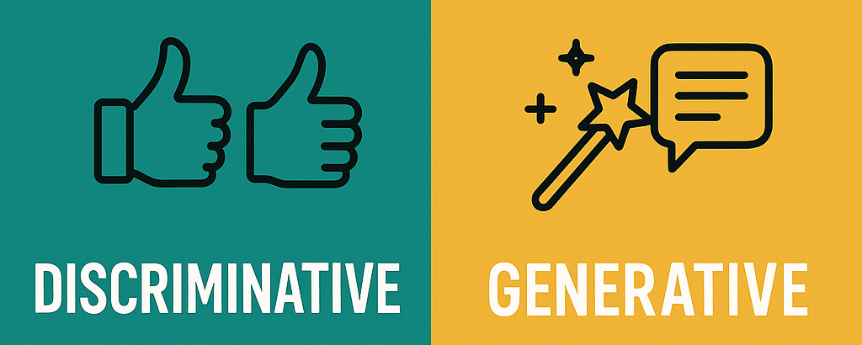
“Generative”?
• In the past, most language models were used for classification e.g. spam detection, sentiment analysis
• Generative models generate outputs based on prompts
VS

Slide 18
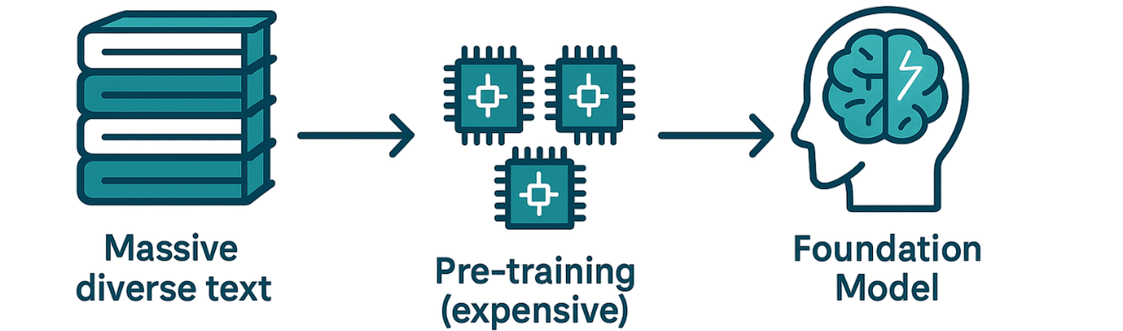
“Pre-trained”?
• Our n-gram model (and many ML models) are small/simple enough to be trained quickly on new datasets or tasks.
• But GPTs need to be first pre-trained on massive datasets using lots of power and computation
• This creates a foundation model with important knowledge (grammar, facts, reasoning patterns)

Slide 19
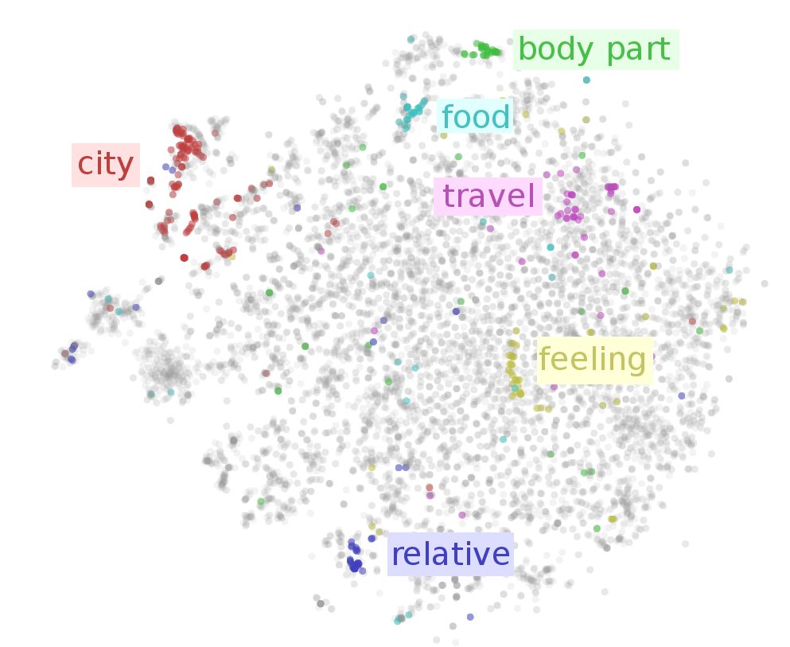

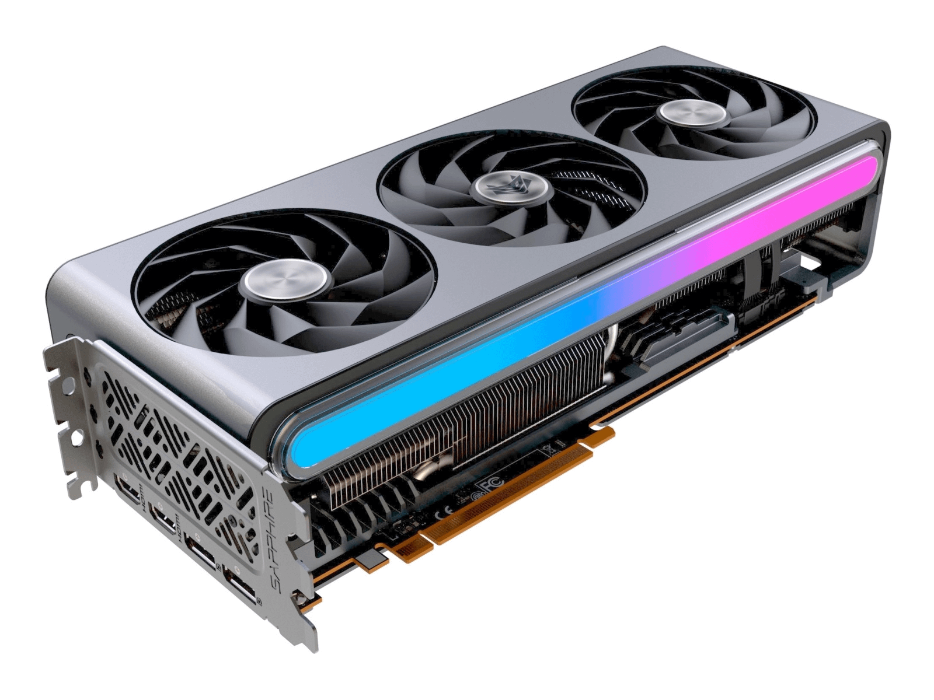
“Transformer”?
A special type of neural network (machine learning technique) that is great for language modeling.
Technique published in 2017 by a Google team.
1. Sees the bigger picture
• Much longer context
• Decides which words matter for prediction (smart highlighter)
2. Rich internal representation of word meanings
3. Trains really well on modern GPUs

Slide 20
Check your understanding
In contrast to earlier classification models, “generative” LLMs can… A. Assign a label (e.g. spam/not spam) to an input B. Produce new text based on a prompt
What does “pre-trained” mean in GPT? A. The model is manually trained with grammar rules B. It’s first trained on massive unlabeled text, then fine-tuned on tasks C. Comes pre-loaded with a fixed set of responses to common questions.
What kind of data does a language model use during its next-token pre-training phase? A. Large amounts of raw, unlabeled text from the web B. Human-annotated examples of question–answer pairs

Slide 21
The Evolution of the GPTs

Slide 22

GPT-N series: Evolution of Models
Model (year) | Model Innovation | “Can you tell me who the current pope is” | Training Corpus Size (Estimate)
GPT-1 → GPT-3 (2018-2020) | Next-token prediction (pretraining) | “Because I'm dying for that information” Autocomplete of typical trained text. Ignores the question’s intent. | ~1 B → 300 B tokens (5 GB → 45 TB raw)
ChatGPT-3.5 (2022) | Instruction-following fine-tune + RLHF | “Pope Francis is the current pope” Model follows instruction but is stale. | GPT‑3 base 300 B + ≲ 1 B RLHF tokens
ChatGPT-4 (2023-2024) | Tool-use fine-tune or tool-use system prompt | “The Church is currently without a pope” Knows how to use Google to get up-to-date information. | ~ 10–13 T tokens (undisclosed)
o-series (o1, o3) (2024-2025) | Chain-of-thought deliberation | (THINKING)…quietly reasons, runs a quick search… “The Church is currently without a pope” More capable with using Google and other tools to arrive at answers. | ~ 10-20 T pre-training tokens + large-scale RL & tool-use fine-tuning (exact size undisclosed)

Slide 23
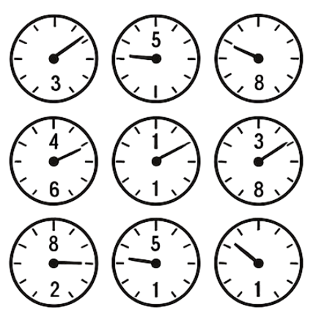
Next-token prediction. How a language model is pre-trained
Language model
(millions of parameters/weights encoding mathematical functions)
Training data:
Billions of sequences with known, masked completions
Model “guesses”, and learns from mistake
Bok: 3%
Tap: 2%
Cat: 1%
…
Hill: 0.05%
Jack and Jill went up the _____
Each word is represented by high-dimensional vector (series of numbers)
Learning algorithm (gradient descent) calculates how far the guessed answers are from the correct answer and nudges the weight “dials” in an intelligent way improve probability of the correct answer

Slide 24
Next-token prediction. How a language model is pre-trained
Language model
(millions of parameters/weights encoding mathematical functions)
Training data:
Billions of sequences with known, masked completions
Model “guesses”, and learns from mistake
Hill: 14%
Mountain: 11%
Cat: 9%
…
Jack and Jill went up the _____
Each word is represented by high-dimensional vector (series of numbers)
Learning algorithm (gradient descent) calculates how far the guessed answers are from the correct answer and nudges the weight “dials” in an intelligent way improve probability of the correct answer

Slide 25



Data GPT-3 trained on
570 GB of text
= ~100,000 bibles worth of text
etc.

Slide 26
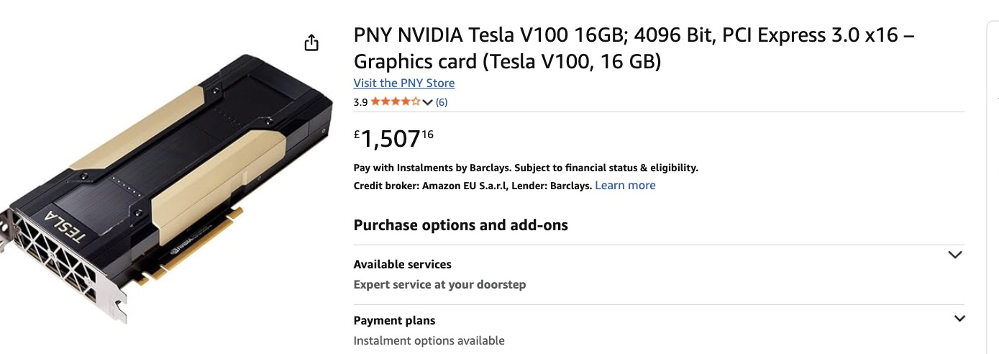
Compute GPT-3 trained with
~ 1000 NVIDIA v100 GPUs running non-stop for ~1 month

Slide 27
Check your understanding
What is the core training objective in next-token prediction? A. Maximize the probability of each next token given its preceding context B. Classify each input sequence into predefined categories

Slide 28
GPT-N series: Evolution of Models
Model (year) | Model Innovation | “Can you tell me who the current pope is” | Training Corpus Size (Estimate)
GPT-1 → GPT-3 (2018-2020) | Next-token prediction (pretraining) | “Because I'm dying for that information” Autocomplete of typical trained text. Ignores the question’s intent. | ~1 B → 300 B tokens (5 GB → 45 TB raw)
ChatGPT-3.5 (2022) | Instruction-following fine-tune + RLHF | “Pope Francis is the current pope” Model follows instruction but is stale. | GPT‑3 base 300 B + ≲ 1 B RLHF tokens
ChatGPT-4 (2023-2024) | Tool-use fine-tune or tool-use system prompt | “The Church is currently without a pope” Knows how to use Google to get up-to-date information. | ~ 10–13 T tokens (undisclosed)
o-series (o1, o3) (2024-2025) | Chain-of-thought deliberation | (THINKING)…quietly reasons, runs a quick search… “The Church is currently without a pope” More capable with using Google and other tools to arrive at answers. | ~ 10-20 T pre-training tokens + large-scale RL & tool-use fine-tuning (exact size undisclosed)

Slide 29
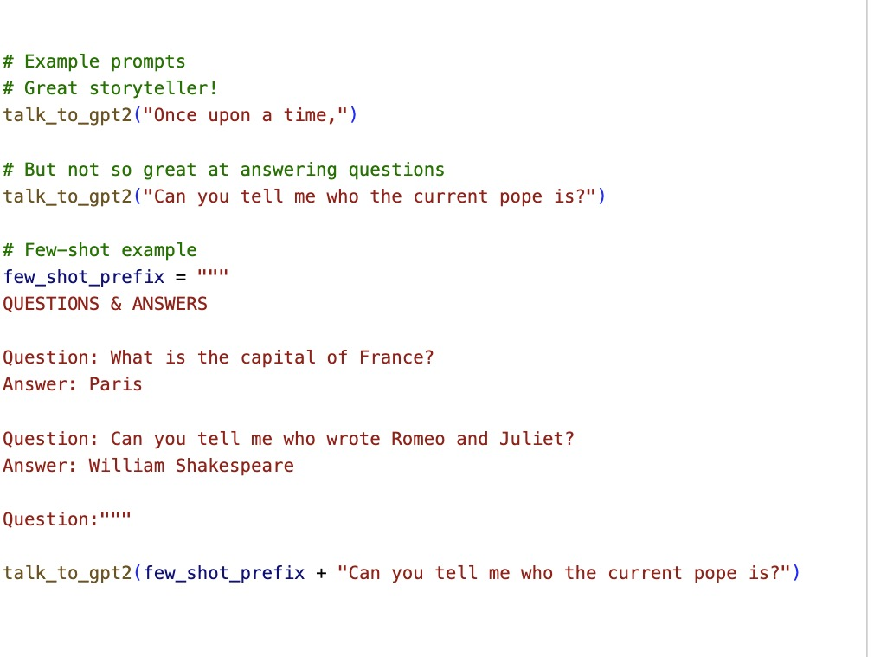
Live demo: Next-token predictors are not that helpful
Summary of Demo
Basic Text Completion - GPT-2 generates creative continuations to prompts but not great at question answering.
Example Prompting- Few-shot prompts improved GPT-2's ability to follow instructions and answer questions.
Structure Control - Adding special tokens like "<EOM>" helps control output

Slide 30
Check your understanding
Why might a purely pretrained language model (like GPT-2) struggle with direct questions?
A. It’s trained to continue text, not to give accurate answers
B. It lacks enough memory for simple factual questions
C. It cannot recognize language patterns at all

Slide 31
GPT-N series: Evolution of Models
Model (year) | Model Innovation | “Can you tell me who the current pope is” | Training Corpus Size (Estimate)
GPT-1 → GPT-3 (2018-2020) | Next-token prediction (pretraining) | “Because I'm dying for that information” Autocomplete of typical trained text. Ignores the question’s intent. | ~1 B → 300 B tokens (5 GB → 45 TB raw)
ChatGPT-3.5 (2022) | Instruction-following fine-tune + RLHF | “Pope Francis is the current pope” Model follows instruction but is stale. | GPT‑3 base 300 B + ≲ 1 B RLHF tokens
ChatGPT-4 (2023-2024) | Tool-use fine-tune or tool-use system prompt | “The Church is currently without a pope” Knows how to use Google to get up-to-date information. | ~ 10–13 T tokens (undisclosed)
o-series (o1, o3) (2024-2025) | Chain-of-thought deliberation | (THINKING)…quietly reasons, runs a quick search… “The Church is currently without a pope” More capable with using Google and other tools to arrive at answers. | ~ 10-20 T pre-training tokens + large-scale RL & tool-use fine-tuning (exact size undisclosed)

Slide 32
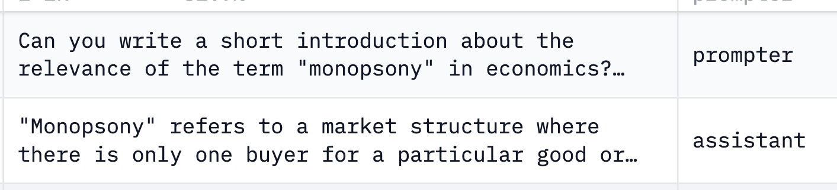

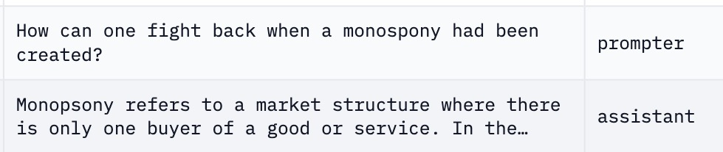
Instruction fine-tuning: From autocomplete to helpful assistant
Training the base model on demonstrations of desired assistant behaviors using human-written instructions and responses.
Example training data
Quite expensive. Need lots of humans
https://huggingface.co/datasets/OpenAssistant/oasst1/viewer/default/train?views%5B%5D=train

Slide 33
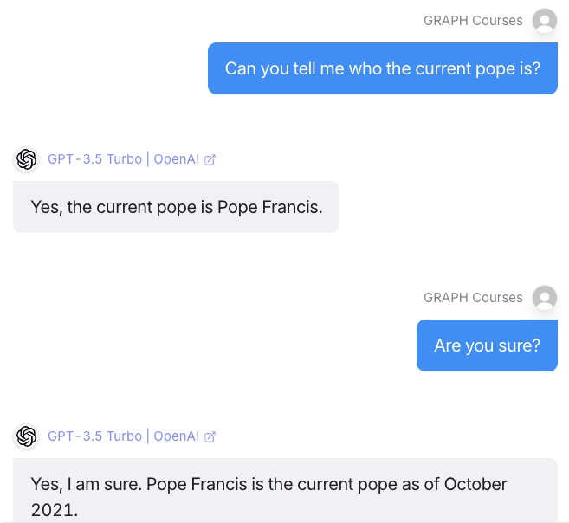
Live demo: Using ChatGPT 3.5
Summary of Demo
Instruction-tuning has turned a powerful autocomplete into a helpful assistant.
But training data is stale (stuck at the point when the data for pre-training was scraped)

Slide 34
Check your understanding
The key innovation that distinguished ChatGPT-3.5 from earlier GPT models (like GPT-3) was its significantly improved capability for:
A) Accessing and incorporating real-time information from the internet.
B) Generating much longer and more varied styles of text.
C) Understanding and following instructions to act as an assistant.

Slide 35
GPT-N series: Evolution of Models
Model (year) | Model Innovation | “Can you tell me who the current pope is” | Training Corpus Size (Estimate)
GPT-1 → GPT-3 (2018-2020) | Next-token prediction (pretraining) | “Because I'm dying for that information” Autocomplete of typical trained text. Ignores the question’s intent. | ~1 B → 300 B tokens (5 GB → 45 TB raw)
ChatGPT-3.5 (2022) | Instruction-following fine-tune + RLHF | “Pope Francis is the current pope” Model follows instruction but is stale. | GPT‑3 base 300 B + ≲ 1 B RLHF tokens
ChatGPT-4 (2023-2024) | Tool-use fine-tune or tool-use system prompt | “The Church is currently without a pope” Knows how to use Google to get up-to-date information. | ~ 10–13 T tokens (undisclosed)
o-series (o1, o3) (2024-2025) | Chain-of-thought deliberation | (THINKING)…quietly reasons, runs a quick search… “The Church is currently without a pope” More capable with using Google and other tools to arrive at answers. | ~ 10-20 T pre-training tokens + large-scale RL & tool-use fine-tuning (exact size undisclosed)

Slide 36
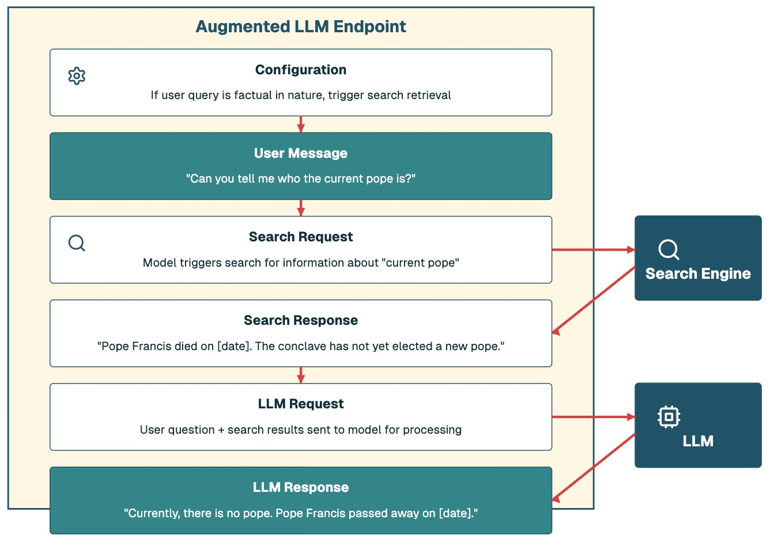
Tool use (fine-tune/system prompt): Teaching model to use tools

Slide 37
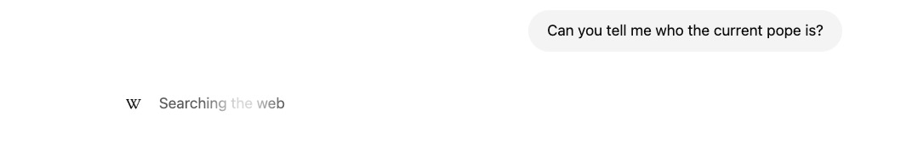
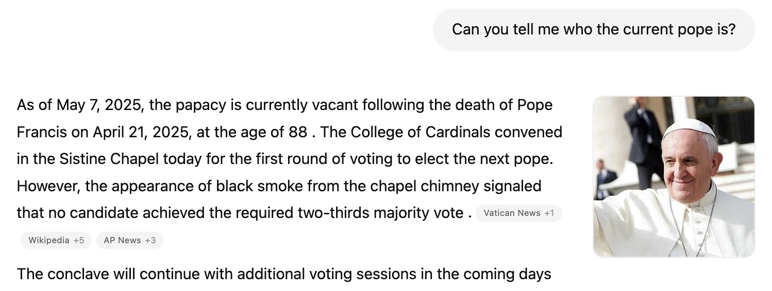
Live demo: Using ChatGPT-4

Slide 38
Check your understanding
“Tool-use” fine-tuning (e.g. in GPT-4) teaches the model to…
A. Write its own training code
B. Call external APIs like Search or utilities like calculators when needed
C. Compress its parameters to fit on smaller/lighter devices when needed

Slide 39
GPT-N series: Evolution of Models
Model (year) | Model Innovations | “Can you tell me who the current pope is” | Training Corpus Size (Estimate)
GPT-1 → GPT-3 (2018-2020) | Next-token prediction (pretraining) | “Because I'm dying for that information” Autocomplete of typical trained text. Ignores the question’s intent. | ~1 B → 300 B tokens (5 GB → 45 TB raw)
ChatGPT-3.5 (2022) | Instruction-following fine-tune + RLHF | “Pope Francis is the current pope” Model follows instruction but is stale. | GPT‑3 base 300 B + ≲ 1 B RLHF tokens
ChatGPT-4 (2023-2024) | Tool-use fine-tune or tool-use system prompt | “The Church is currently without a pope” Knows how to use Google to get up-to-date information. | ~ 10–13 T tokens (undisclosed)
o-series (o1, o3) (2024-2025) | Chain-of-thought deliberation | (THINKING)…quietly reasons, runs a quick search… “The Church is currently without a pope” More capable with using Google and other tools to arrive at answers. | ~ 10-20 T pre-training tokens + large-scale RL & tool-use fine-tuning (exact size undisclosed)

Slide 40
Chain-of-Thought Reinforcement: Teaching models to think out loud
Sam had 20 balloons, gave 4 balloons to each of his 3 friends, and then found 5 more balloons. How many balloons does Sam have now? (Show your work)
Reinforce
(reward) correct solution path
🤖 LLM
Model Output (Trace 1 – Correct)
• Sam begins with 20 balloons. • He gives each of his 3 friends 4 balloons (total given: 4 × 3 = 12). • Remaining after giving: 20 − 12 = 8. • He then finds 5 more balloons. • Total balloons now = 8 + 5 = 13. ### 13
Model Output (Trace 2 – Wrong)
• Sam starts with 20 balloons.
• He gives each of his 3 friends 4 balloons (4 × 3 = 12).
• So we add: 20 + 12 = 32.
• He then finds 5 more balloons.
• Total balloons now = 32 + 5 = 37.
### 37
Ground truth:
13

Slide 41
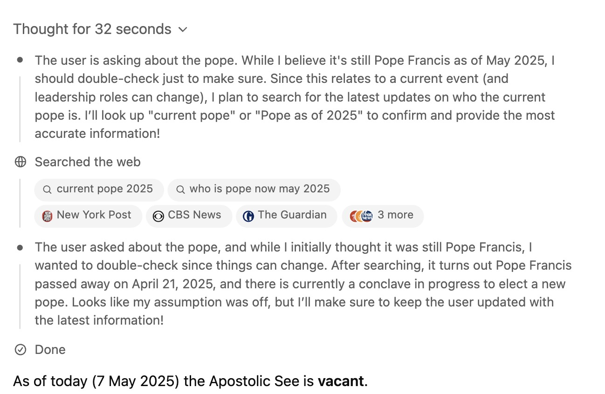
Live demo: Using o3

Slide 42
Check your understanding
Encouraging "Chain-of-Thought" processes in LLMs, where the model "thinks out loud" or shows its work, is primarily aimed at:
A. Significantly reducing the computational resources needed to generate a response.
B. Improving the model's reasoning process and its ability to correctly solve more complex, multi-step problems.

Slide 43
GPT-N series: Evolution of Models
Model (year) | Model Innovations | “Can you tell me who the current pope is” | Training Corpus Size (Estimate)
GPT-1 → GPT-3 (2018-2020) | Next-token prediction (pretraining) | “Because I'm dying for that information” Autocomplete of typical trained text. Ignores the question’s intent. | ~1 B → 300 B tokens (5 GB → 45 TB raw)
ChatGPT-3.5 (2022) | Instruction-following fine-tune + RLHF | “Pope Francis is the current pope” Model follows instruction but is stale. | GPT‑3 base 300 B + ≲ 1 B RLHF tokens
ChatGPT-4 (2023-2024) | Tool-use fine-tune or tool-use system prompt | “The Church is currently without a pope” Knows how to use Google to get up-to-date information. | ~ 10–13 T tokens (undisclosed)
o-series (o1, o3) (2024-2025) | Chain-of-thought deliberation | (THINKING)…quietly reasons, runs a quick search… “The Church is currently without a pope” More capable with using Google and other tools to arrive at answers. | ~ 10-20 T pre-training tokens + large-scale RL & tool-use fine-tuning (exact size undisclosed)

Slide 44
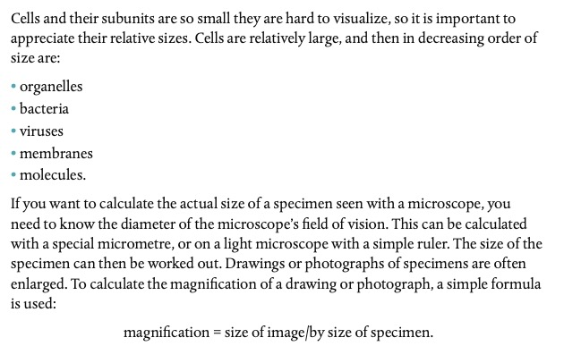
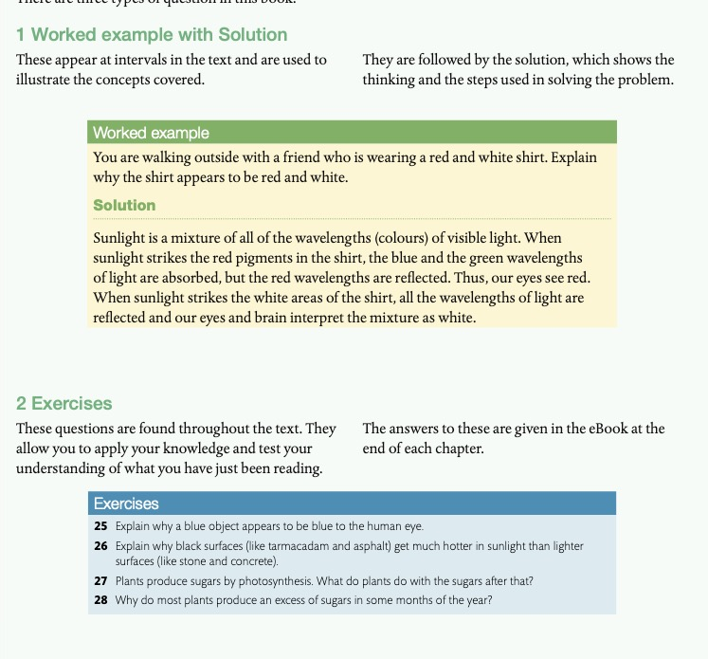

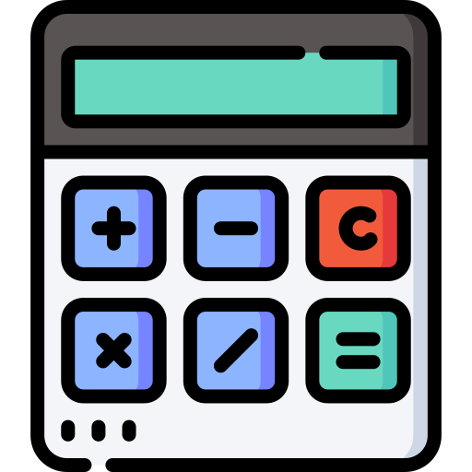
An analogy to human learning
Model (year) | Model Innovations
GPT-1 → GPT-3 (2018-2020) | Next-token prediction (pretraining)
ChatGPT-3.5 (2022) | Instruction-following fine-tune + RLHF
ChatGPT-4 (2023-2024) | Tool-use fine-tune or tool-use system prompt
o-series (o1, o3) (2024-2025) | Chain-of-thought deliberation
Pretraining ⬌ Exposition
(background knowledge)
Instruction Fine-tune ⬌ Worked Examples
(problem + solution for imitation)
Tool Fine-tune ⬌ Calculator Instructions
Showing how to use tools
Calculator and Google use are allowed
Chain of Thought RL ⬌ Practice Exercises
Prompt to practice, trial & error till you reach the correct answer

Slide 45
Caveats of our “history”
• Left out some important innovations:
- Multimodality (4 to 4o)
- Longer context length
• Only focused on one company, but similar sequence in others (Anthropic, Google, Meta)
• Simplifications for approachability

Slide 46
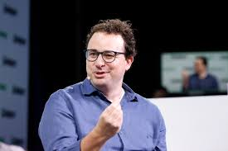
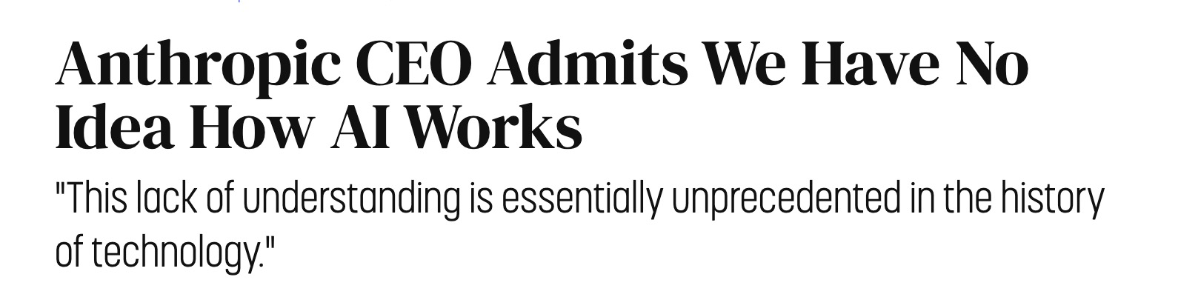
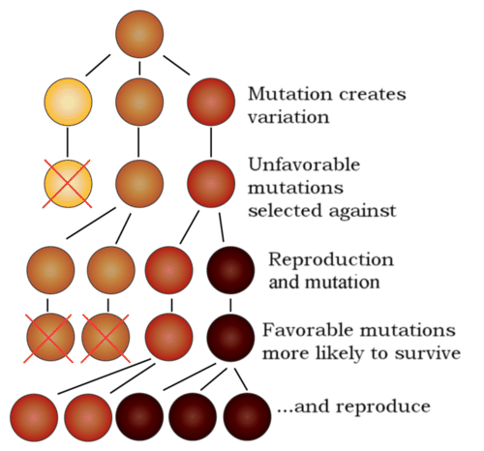
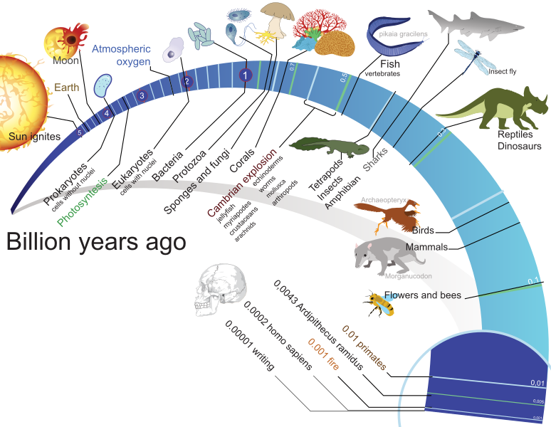
But how can such simple training procedures give rise to intelligence?! Two responses
1: You’re in good company!
2: Consider the other simple procedure that gave rise to intelligence when scaled over trillions of iterations: natural selection/evolution

Slide 47


Why learn the history of LLMs?
Forecasting requires understanding the past
Pitfalls can be better avoided

Slide 48
Future trends
Improving Intelligence
Expanding Context
The rapid pace from GPT-1 (2018) to o3 (2025) suggests increasingly improving capabilities ahead.
Models will handle increasingly larger documents and conversations natively.
Better Multimodality
Agentic Systems
Integration of text, image, audio, and video in unified models.
Reasoning models are glimpse into a future of agents that can plan, execute tasks, and learn from their experiences.

Slide 49
Persistent Limitations
Hallucination
Models have little self-knowledge
Models are still autocompleters and storytellers (though very intelligent ones). Hallucination problems persist and are built into how the models are trained.
Models are trained on internet text. Have little knowledge of their own limitations. Often overconfident.
Knowledge Staleness
Compute Costs
Base models only know information up to their training cutoff date.
Training and running models is expensive in compute and therefore in dollars. The main players are very rich companies.
Privacy Concerns
Bias Issues
Because of the compute needs, it's hard to train or run your own models locally. Privacy will continue to be an issue.
Models reflect biases present in their training data

